Slide 1
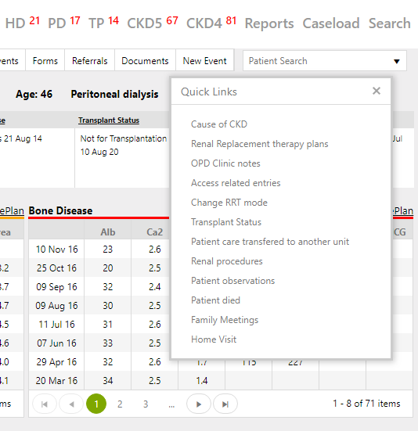
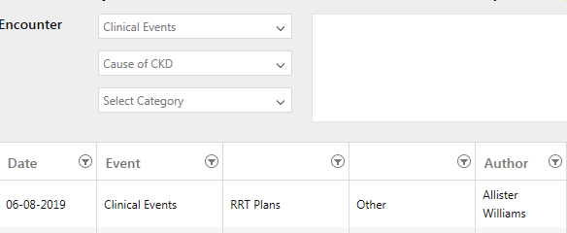
HOW TO ENTER: Cause of CKD
Click on New Events – QuickLinks
Choose “Cause of CKD”
Click on drop down and select the cause
In FreeText you can copy/paste the rest of Medical Background
Copy and paste
Rest of medical
background
NOTE: Some QuickLinks also accessed from Summary Page
Click on drop down and select the cause
You can search by entering FIRST LETTER of the list
Events: HOW TO?
Quick Links: CKD Cause
Using Forms
Attachments

Slide 2
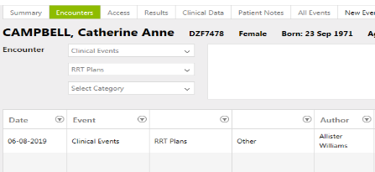
HOW TO ENTER: RRT Plans
Click on New Events – QuickLinks
Choose “RRT Plans”
Click on drop down and select the RRT plan for patient
In FreeText you can type more details of the Plan if required
Type more details
here
NOTE: Some QuickLinks also accessed from Summary Page
Click on drop down and select the RRT Plan.
You can search by entering FIRST LETTER of the list
Events: HOW TO?
Quick Links: RRT plans
Using Forms
Attachments

Slide 3
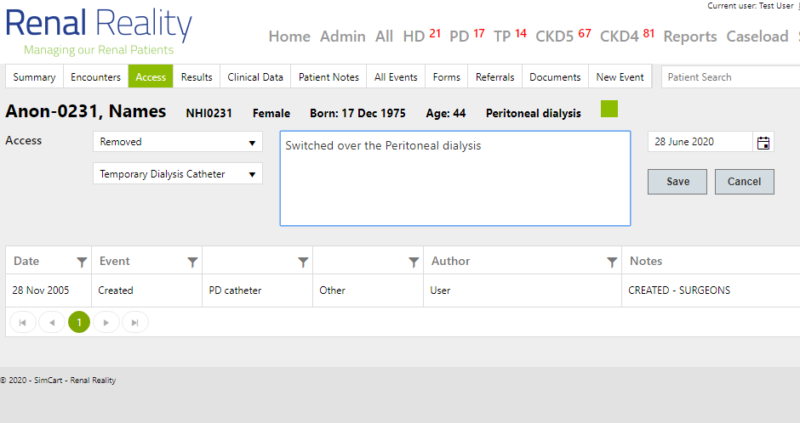
HOW TO ENTER: Dialysis Access changes
Click on New Events – QuickLinks
Choose “Access related entries”
Click on drop down and select the RRT plan for patient
In FreeText you can type more details of the Plan if required
Type more details
here
NOTE: Some QuickLinks also accessed from Summary Page
Click on drop down and select the Access change, ie CREATE or REMOVE or PROBLEMS. The you can choose the type of access and what was done with the access.
Events: HOW TO?
Quick Links: RRT Access
Using Forms
Attachments

Slide 4
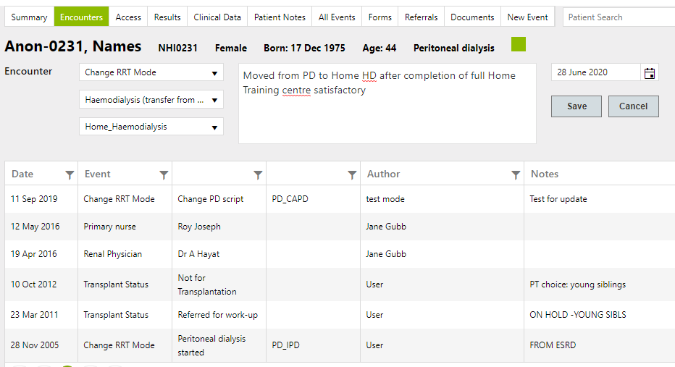
HOW TO ENTER: Change in RRT modality
Click on New Events – QuickLinks
Choose “Change RRT mode”
Click on drop down and select the RRT modality change
In FreeText you can type more details of the Plan if required
Type more details here
NOTE: Some QuickLinks also accessed from Summary Page
Click on drop down and select the RRT modality change you want to enter: Make sure you follow exact prescribed options for your unit
Events: HOW TO?
Quick Links: RRT Change
Using Forms
Attachments

Slide 5
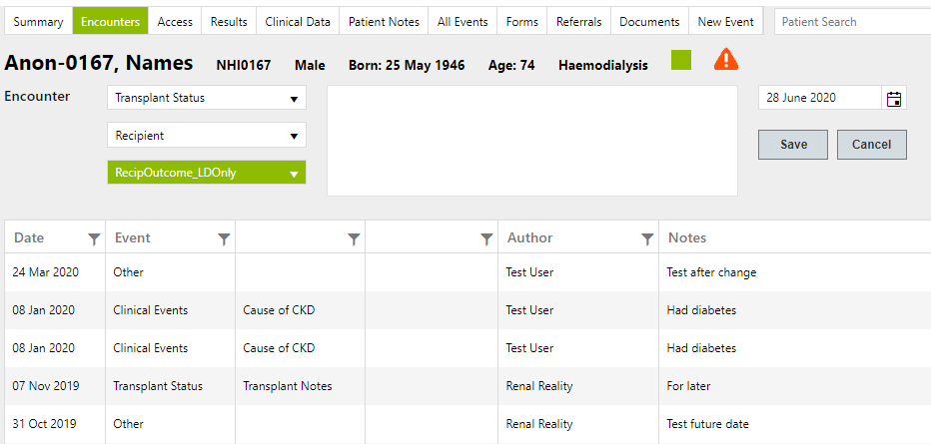
HOW TO ENTER: Change in Transplant status
Click on New Events – QuickLinks
Choose “Transplant status”
Click on drop down and select the CHANGE in Tplant status
In FreeText you can type more details of the Plan if required
Type more details here
NOTE: Some QuickLinks also accessed from Summary Page
Click on drop down and select the RRT modality change you want to enter: Make sure you follow exact prescribed options for your unit
Events: HOW TO?
Quick Links: Transplants
Using Forms
Attachments

Slide 6
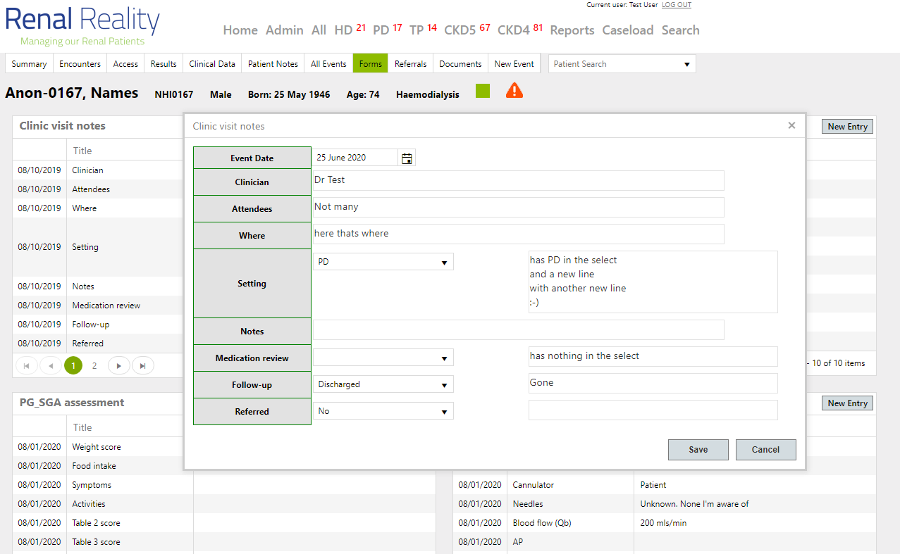
Using FORMS to enter Clinical events
New events on Forms
Data items collected together combined in forms. These forms can be created on request
For entering clusters of events associated with each other
Easier to enter data in clusters
With prefilled choices
Most clinical events entered within predefined options
Events
Quick Links
Using Forms 1/4
Attachments

Slide 7
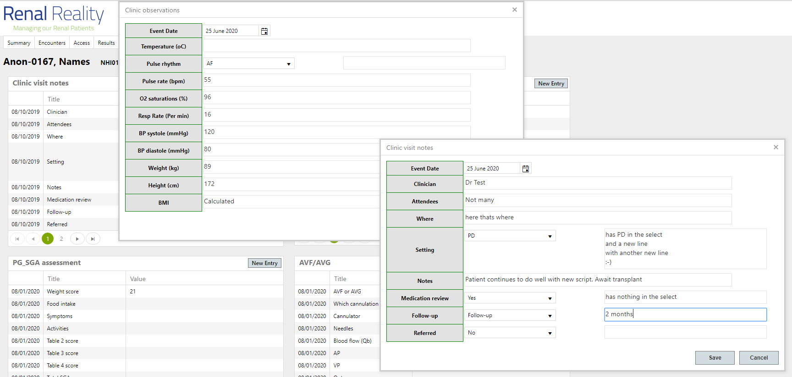
Using multiple forms to enter events
Form 1 used on background
Events sometimes happens at the same time
Form2 used at front end
And allows you to interact with background data and new events simultaneously
Background remain and accessible to review
When decision on front end based on historical data
Events
Quick Links
Using Forms 2/4
Attachments

Slide 8
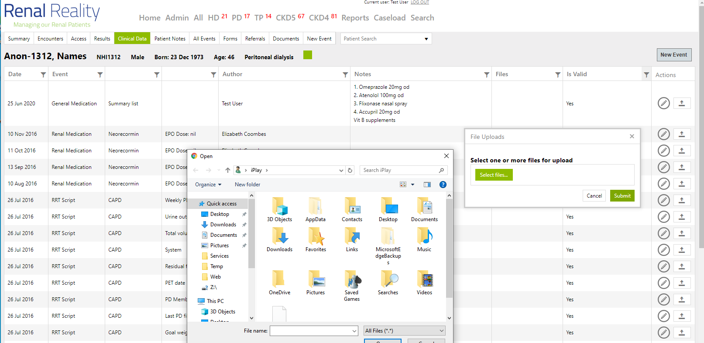
Adding attachments (files) to clinical events
A File can be attached to any event
After entering any event you can add a file from your desktop
Here you can select to upload
Just like any other file upload feature
From your computer you can select any file
Any format allowed
Events
Quick Links
Using Forms
Attachments 1/3

Slide 9
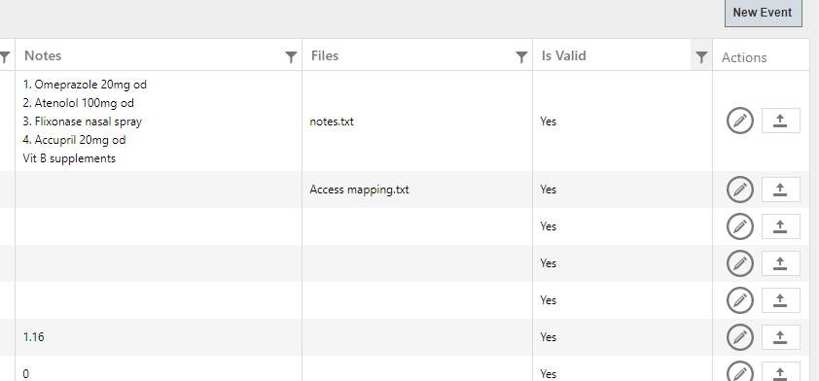
Access to attachments
File then accessible for users
Next time a user access these events, attachments can be opened and viewed
Description (Name) of file
Best to name the file to allow other users some form of guidance what was attached
Validation of events
After attached, files and entries can be made non-valid with a full audit trail to track changes
Events
Quick Links
Using Forms
Attachments 2/3

